Slide 1
Sales Analysis of Online Games

Slide 2
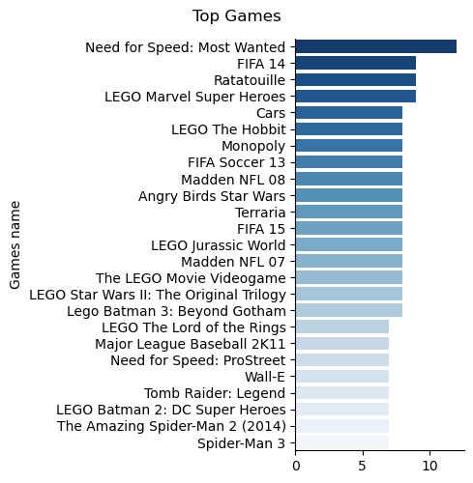
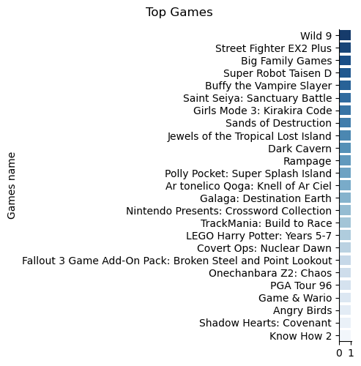
Univariate analysis - Name
top 25 games sold
Bottom 25 games sold

Slide 3
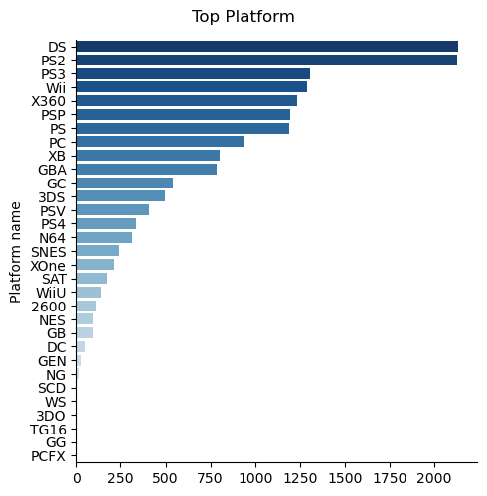
Univariate analysis - Platform
Insight:-
Most games are sold on platforms as below
DS
PS2
Wii
X360P
PSP
PS
PC

Slide 4
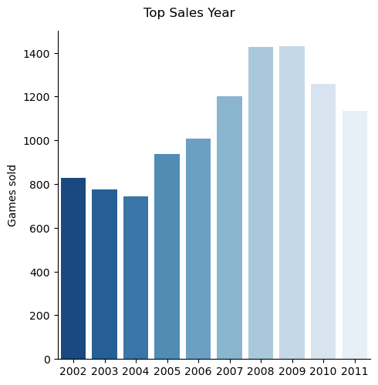
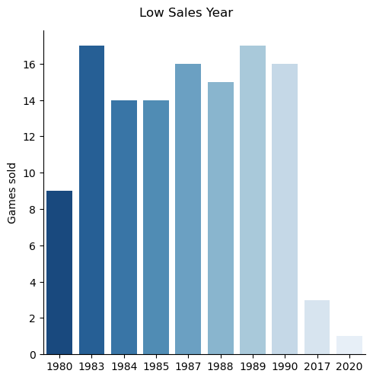
Univariate analysis - Year
Highest sale year =2009 , Lowest sale year= 2020

Slide 5
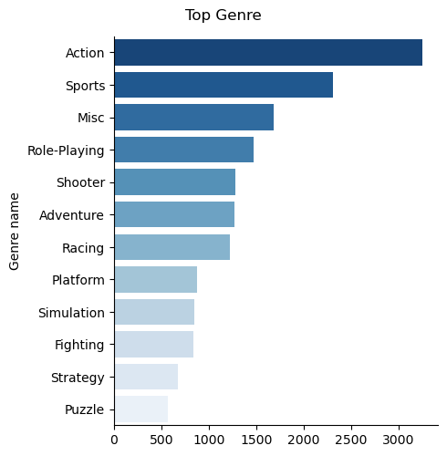
Univariate analysis - Genre
Insight:
Action and Sports are top selling Genre games
Puzzle and Strategy are lowest selling Genre games

Slide 6
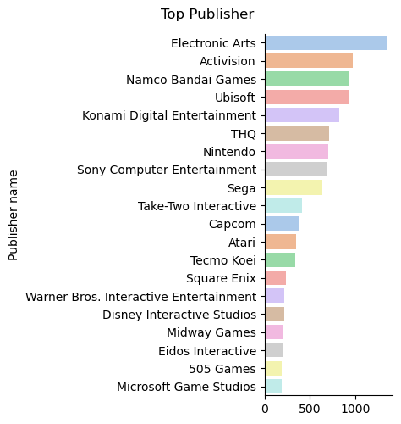
Univariate analysis - Publisher
Insight:
Electronic arts and Activision are top selling Genre games
Microsoft Game studio is lowest selling Genre games

Slide 7
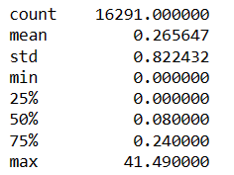
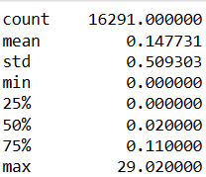
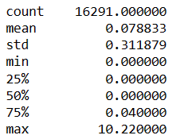
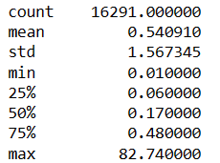
Univariate analysis – Sales columns
NA_Sales
EU_Sales
JP_Sales
Global_Sales
Insight:
75% sales made in all are less than 1% of maximum sales value.

Slide 8
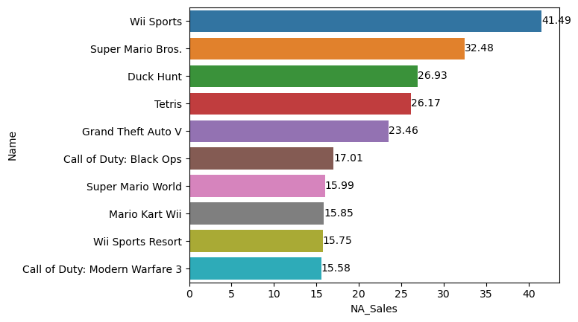
Bivariate analysis – Game vs Top NA_Sales

Slide 9
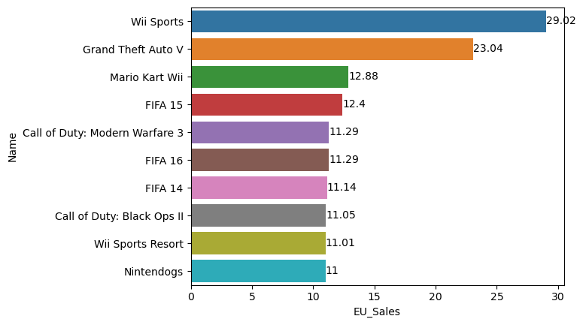
Bivariate analysis – Game vs Top EU_Sales

Slide 10
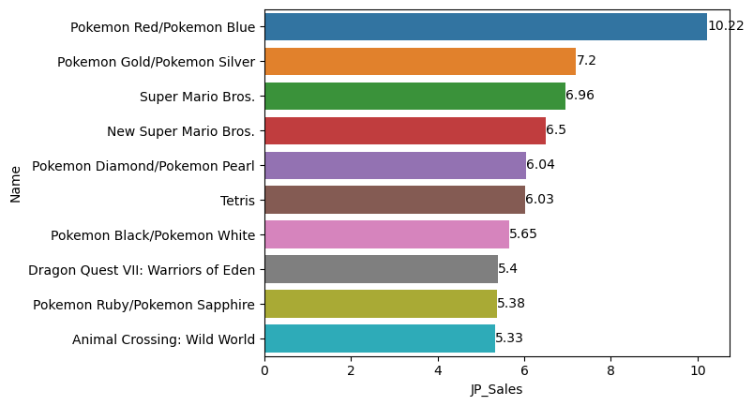
Bivariate analysis – Game vs Top JP_Sales

Slide 11
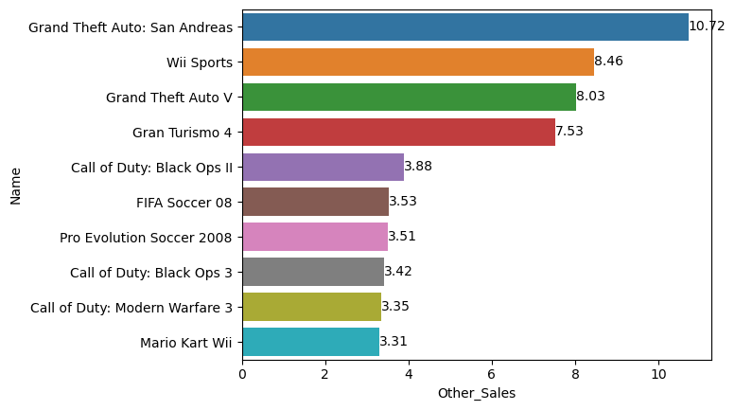
Bivariate analysis – Game vs Top JP_Sales

Slide 12
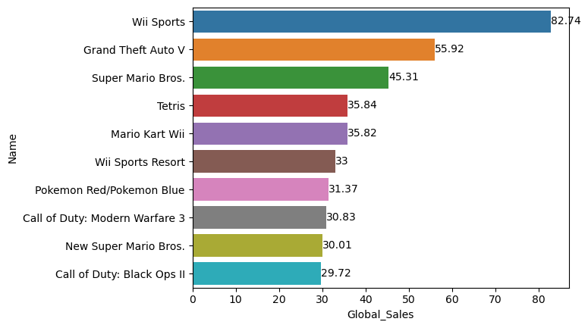
Bivariate analysis – Game vs Top GLobal_Sales

Slide 13
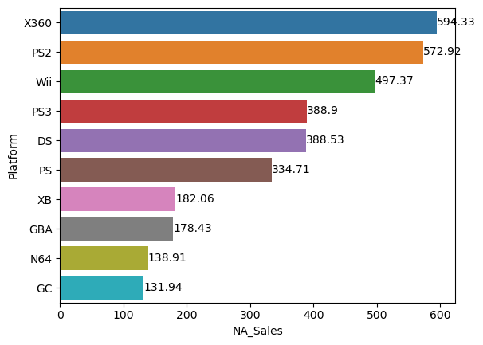
Bivariate analysis – Platform vs Top NA_Sales

Slide 14
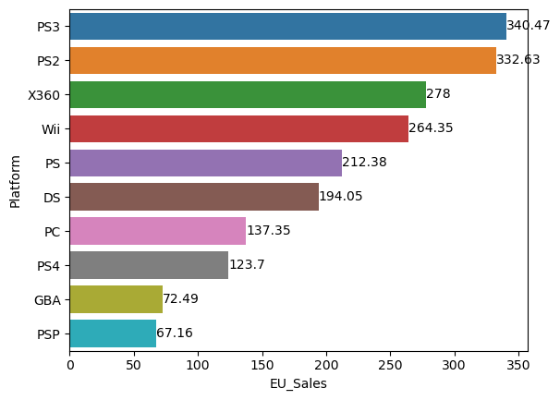
Bivariate analysis –Platform vs Top EU_Sales

Slide 15
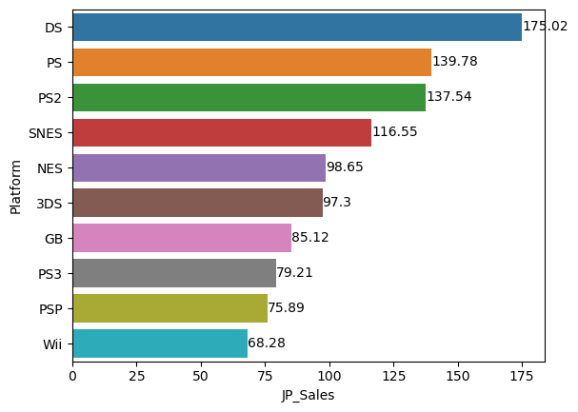
Bivariate analysis –Platform vs Top JP_Sales

Slide 16
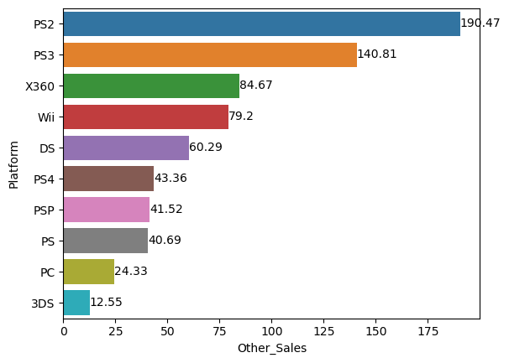
Bivariate analysis –Platform vs Top Other_Sales

Slide 17
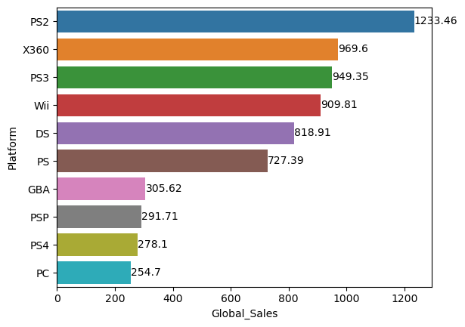
Bivariate analysis –Platform vs Top Global_Sales

Slide 18
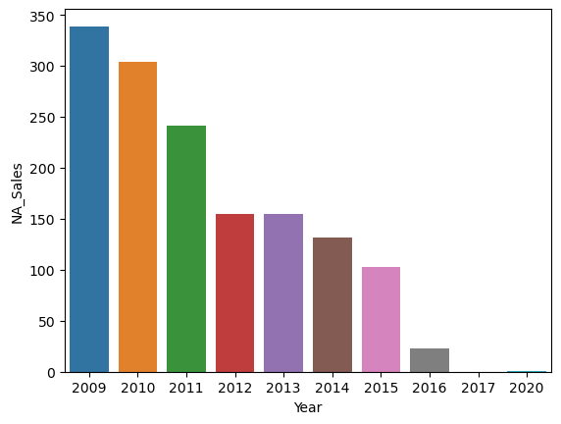
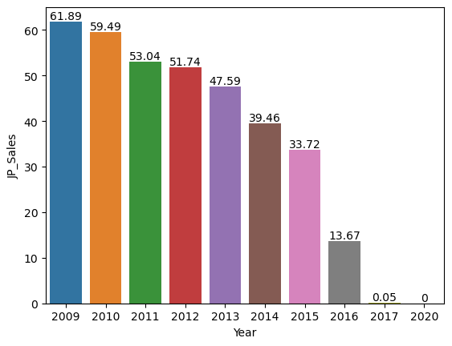
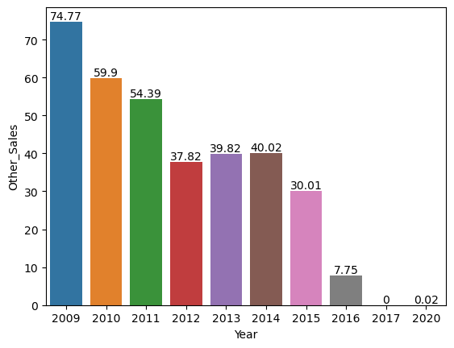
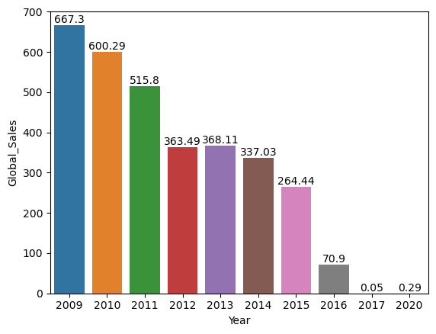
Bivariate analysis –last 10 Year vs Regional_Sales

Slide 19
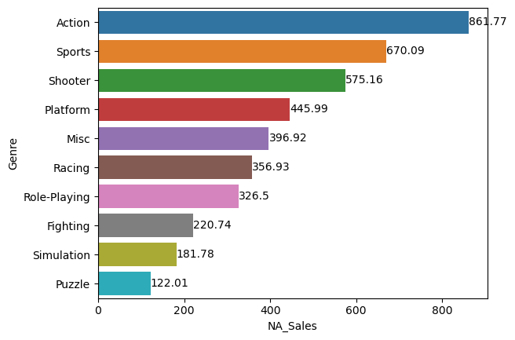
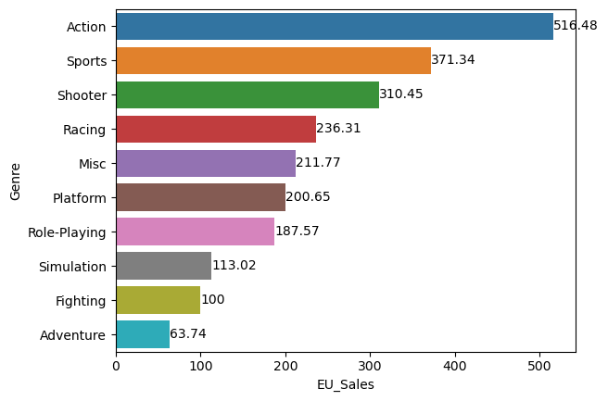
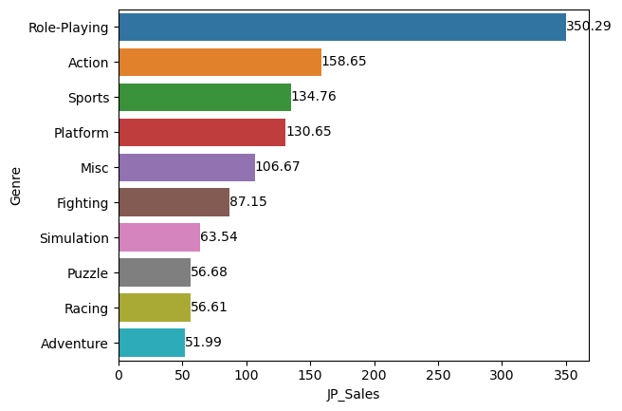
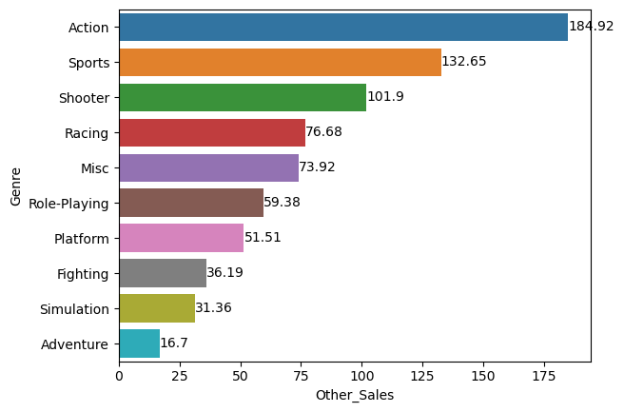
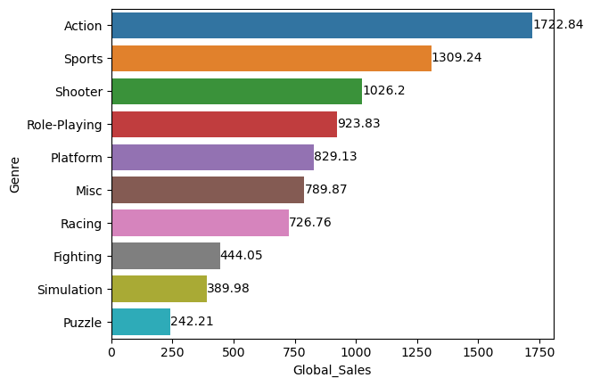
Bivariate analysis –Genre vs top-10 Regional_Sales

Slide 20
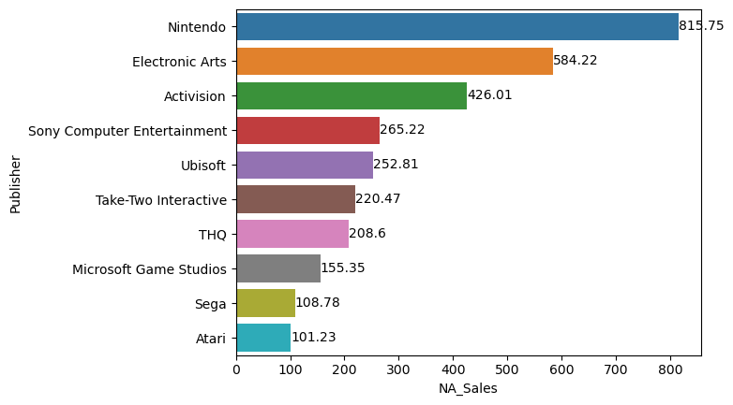
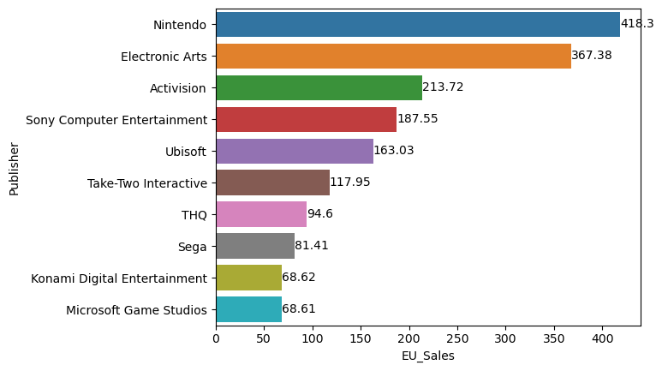
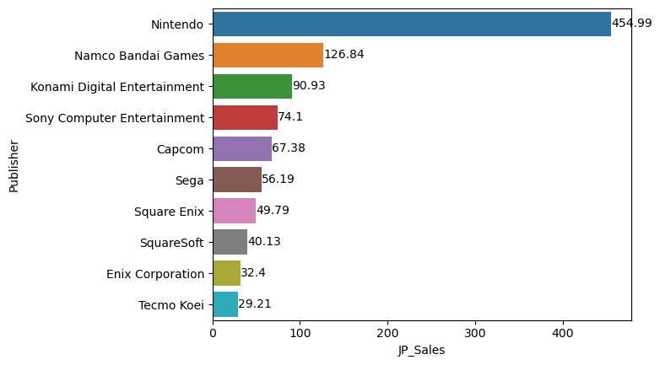
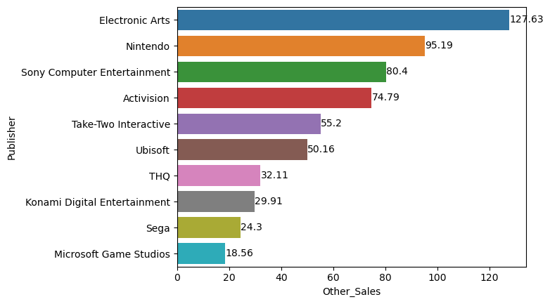
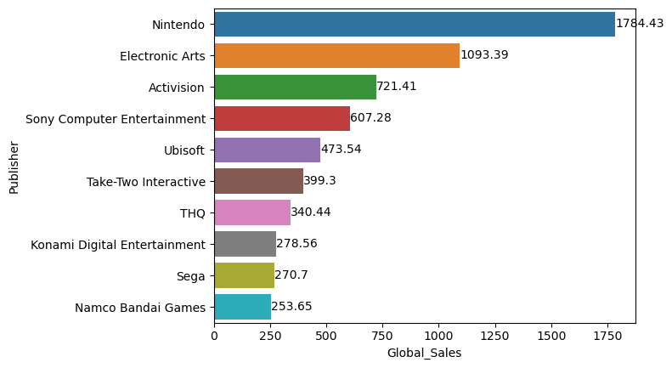
Bivariate analysis –Publisher vs top-10 Regional_Sales

Slide 21
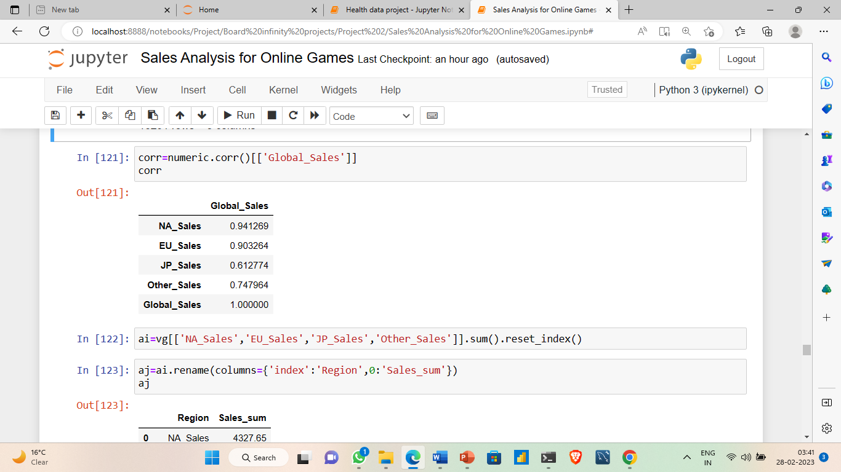
Global sales correlation with regional sales

Slide 22
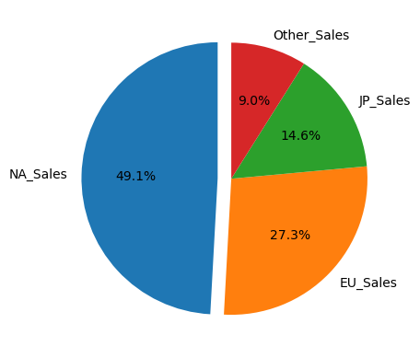
Global sales correlation with regional sales

Slide 23
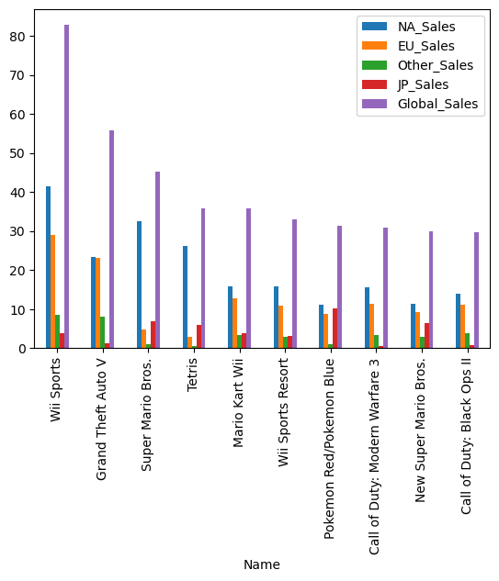
Top selling global game’s region wise analysis

Slide 24
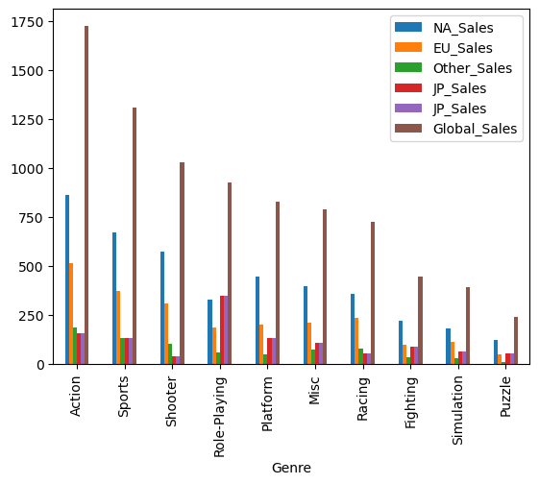
Top selling games’ genre and region wise analysis

Slide 25
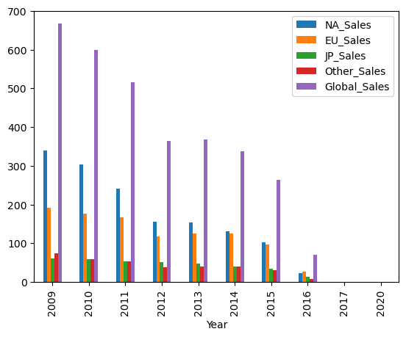
Top selling game’s Year & region wise analysis

Slide 26
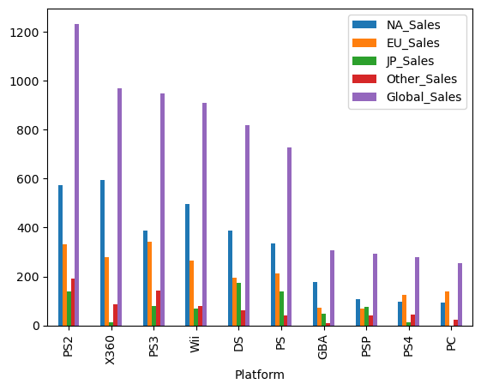
Top selling game’s Platform & Region wise analysis

Slide 27
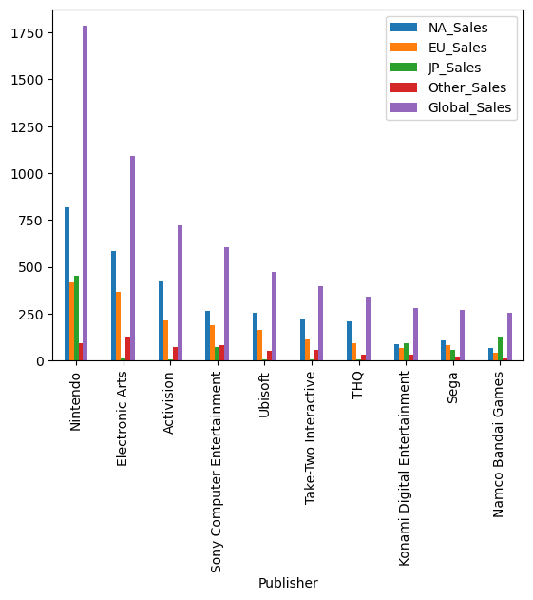
Top selling game’s Publisher & Region wise analysis

Slide 28
Top selling game’s Publisher & Region wise analysis

